Slide 1
Unit 7: Sorting
Prepared by
Gobinda Subedi
BIT, KIST

Slide 2
Chapter Outline
There are many, many different types of sorting algorithms, but the primary ones are:
Selection sort
Bubble sort
Insertion sort
Shell sort
Merge sort
Heapsort
Quicksort

Slide 3
Introduction
Definition:
Sorting is nothing but storage of data in sorted order, it can be in either ascending or descending order.
Sorting algorithms are usually divided into two classes, internal sorting algorithms, which assume that data is stored in an array in main memory, and external sorting algorithm, which assume that data is stored on disk or some other device that is best accessed sequentially.
Sorting arranges data in a sequence which makes searching easier.
We will only consider internal sorting.

Slide 4
Sorting Definition
Sorting algorithms often have additional properties that are of interest, depending on the application. Here are two important properties.
In place sorting
Sorting of a data structure does not require any external data structure for storing the intermediate steps. It is possible to sort very large lists without the need to allocate additional working storage.
Stable sorting
If the same element is present multiple times, then they retain the original relative order of positions.

Slide 5
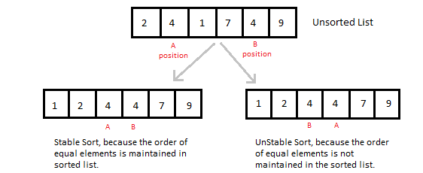
Stable vs Unstable

Slide 6
Sorting Efficiency
There are many techniques for sorting. Implementation of particular sorting technique depends upon situation. Sorting techniques mainly depends on two parameters. First parameter is the execution time of program, which means time taken for execution of program. Second is the space, which means space taken by the program.
The efficiency of an algorithm is always stated as a function of the input size
Worst case scenario :maximum number of computation steps taken on any input size n.

Slide 7
Review of Complexity
Most of the primary sorting algorithms run on different space and time complexity.
Time Complexity is defined to be the time the computer takes to run a program (or algorithm in our case).
Space complexity is defined to be the amount of memory the computer needs to run a program.

Slide 8
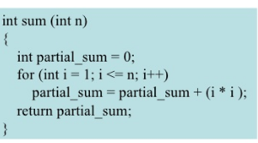
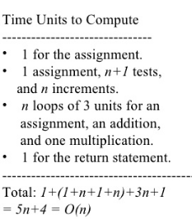
Time Complexity
We assume each operation in a program take one time unit.

Slide 9
Bubble Sort
Definition:
The basic idea of this sort is to pass through the array sequentially several times. Each pass consists of comparing each element in the array with its successor (for example a[i] with a[i + 1]) and interchanging the two elements if they are not in the proper order.
For example, consider the following array:
Link

Slide 10
Bubble Sort
Algorithm:
BubbleSort(A, n)
{
for(i = 0; i <n-1; i++)
{
for(j = 0; j < n-i-1; j++)
{
if(A[j] > A[j+1])
{
temp = A[j];
A[j] = A[j+1];
A[j+1] = temp;
}
}
}
}

Slide 11
Time complexity of Bubble sort
Time Complexity:
Inner loop executes for (n-1) times when i=0, (n-2) times when i=1 and so on: Time complexity = (n-1) + (n-2) + (n-3) + …………………………. +2 +1
= O(n²)
There is no best-case linear time complexity for this algorithm.
Space Complexity:
Since no extra space besides 3 variables is needed for sorting
Space complexity = O(n)

Slide 12
Bubble Sort Analysis
Excellent performance in some cases
But very poor performance in others!
Works best when array is nearly sorted to begin with
Worst case number of comparisons: O(n²)
Best case occurs when the array is already sorted:
O(n) comparisons
O(1) exchanges (none actually)

Slide 13
Improvement of Bubble sort.
BubbleSort(A, n)
{
bool expression
for(i = 0; i <n-1; i++)
{
expression = false;
for(j = 0; j < n-i-1; j++)
{
if(A[j] > A[j+1])
{
temp = A[j];
A[j] = A[j+1];
A[j+1] = temp;
Expression = true
}
}
If (expression == false)
break;
}
}

Slide 14
Selection Sort
This algorithm first finds the smallest element in the array and exchanges it with the element in the first position, then find the second smallest element and exchange it with the element in the second position, and continues in this way until the entire array is sorted.
Selection sorting is conceptually the most simplest sorting algorithm.

Slide 15
Selection Sort
Idea: Find the least (or greatest) value in the array, swap it into the leftmost(or rightmost) component (where it belongs), and then forget that component. Do this repeatedly. Let a[n] be a linear array of n elements.
The selection sort works as follows:
pass 1: Find the location loc of the smallest element in the list of n elements a[0], a[1], a[2], a[3], …......,a[n-1] and then interchange a[loc] and a[0].
Pass 2: Find the location loc of the smallest element in the sub-list of n-1 elements a[1], a[2], a[3], …......,a[n-1] and then interchange a[loc] and a[1] such that a[0], a[1] are sorted.
…..................... and so on.

Slide 16
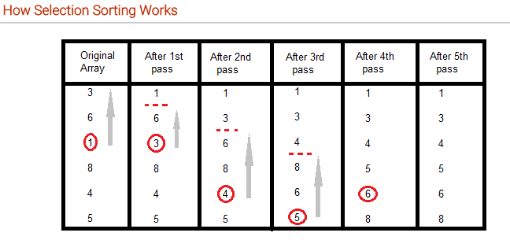
Selection Sort

Slide 17
Selection Sort Contd..
Algorithm:
void selectionSort(int a[], int size)
{
int i, j, min, temp;
for(i=0; i < size-1; i++ )
{
min = i; //setting min as i
for(j=i+1; j < size; j++)
{
if(a[j] < a[min]) //if element at j is less than element at min position
{
min = j; //then set min as j
}
}
temp = a[i];
a[i] = a[min];
a[min] = temp;
}
}

Slide 18
Selection Sort
Time Complexity:
Inner loop executes for (n-1) times when i=0, (n-2) times when i=1 and so on: Time complexity = (n-1) + (n-2) + (n-3) + …………………………. +2 +1
= O(n²)
There is no best-case linear time complexity for this algorithm, but number of swap operations is reduced greatly.
Space Complexity:
Since no extra space besides 5 variables is needed for sorting Space complexity = O(n)

Slide 19
Insertion Sort
It is a simple Sorting algorithm which sorts the array by shifting elements one by one. It is efficient for smaller data sets, but very inefficient for larger lists.
Sorting Idea:
Loop over positions in the array, starting with index 1. Each new position is like the new card handed to you by the dealer, and you need to insert it into the correct place in the sorted subarray to the left of that position.

Slide 20
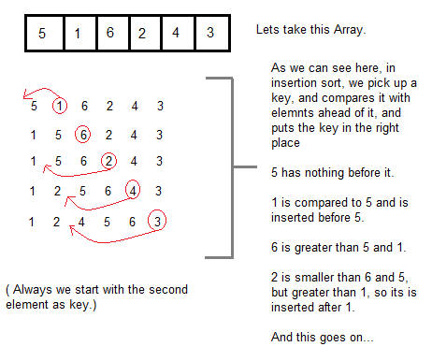
Insertion Sort

Slide 21
Insertion Algorithm
Algorithm:
Insertion(a, n)
{
int i, j, key;
for(i=1; i<n; i++)
{
key = a[i];
j = i-1;
while(j>=0 && key < a[j])
{ a[j+1] = a[j];
j--;
}
a[j+1] = key;
}
}

Slide 22
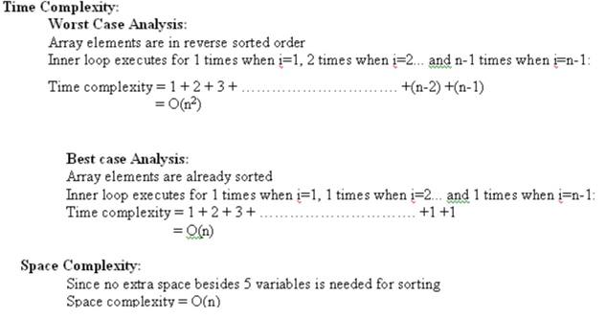
Time Complexity of Insertion sort

Slide 23
Quick Sort
Definition:
Quick Sort, as the name suggests, sorts any list very quickly. Quick sort is not stable search (what is it?), but it is very fast and requires very less aditional space. It is based on the rule of Divide and Conquer(also called partition-exchange sort). This algorithm divides the list into three main parts :
Elements less than the Pivot element
Pivot element
Elements greater than the pivot element

Slide 24
Quick Sort contd..
A quick sort first selects a value, which is called the pivot value.
The role of the pivot value is to assist with splitting the list. The actual position where the pivot value belongs in the final sorted list, commonly called the split point, will be used to divide the list for subsequent calls to the quick sort.
The partition (to divide the list) process will find the split point and at the same time move other items to the appropriate side of the list, either less than or greater than the pivot value.

Slide 25
Divide and Conquer
Divide-and-conquer, breaks a problem into subproblems that are similar to the original problem, recursively solves the subproblems, and finally combines the solutions to the subproblems to solve the original problem.
You should think of a divide-and-conquer algorithm as having three parts:
Divide the problem into a number of subproblems that are smaller instances of the same problem.
Conquer the subproblems by solving them recursively. If they are small enough, solve the subproblems as base cases.
Combine the solutions to the subproblems into the solution for the original problem.

Slide 26
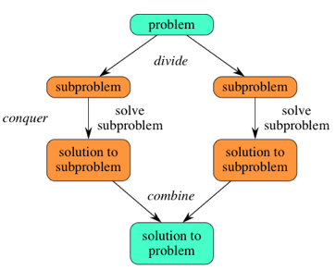
Quick Sort (D & C)
Fig: Divide and Conquer

Slide 27
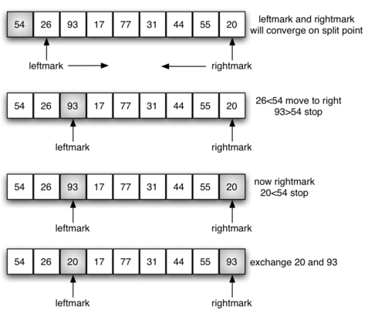
Quick Sort contd..

Slide 28
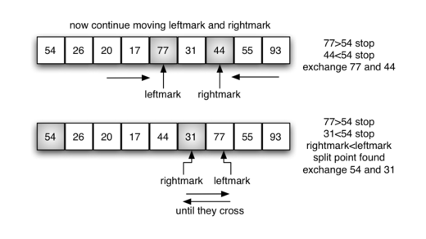
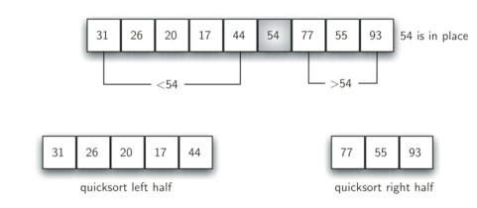
Quick sort contd..

Slide 29
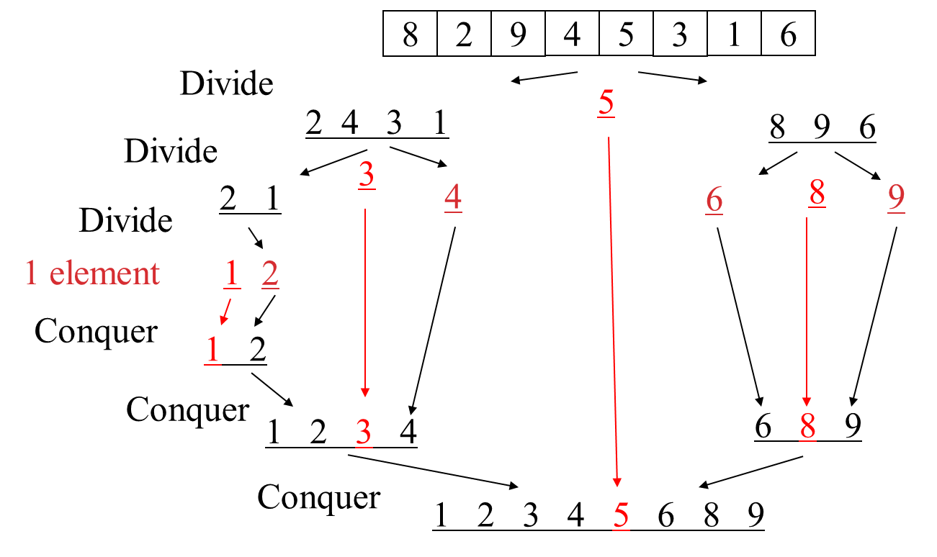
Quick Sort recursion

Slide 30
Quick Sort algorithm.
/* a[] is the array, p is starting index, that is 0, and r is the last index of array. */
void quicksort(int a[], int p, int r) {
if(p < r) {
int q;
q = partition(a, p, r);
quicksort(a, p, q);
quicksort(a, q+1, r);
} }

Slide 31
int partition(int a[], int p, int r)
{ int i, j, pivot, temp;
pivot = a[p]; i = p; j = r;
while(1) {
while(a[i] < pivot && a[i] != pivot) i++;
while(a[j] > pivot && a[j] != pivot) j--;
if(i < j) {
temp = a[i]; a[i] = a[j]; a[j] = temp; }
else return j;
} }

Slide 32
Time Complexity of Quick sort
Best Case:
Divides the array into two partitions of equal size, therefore
T(n) = 2T(n/2) + O(n) , Solving this recurrence we get,
T(n)=O(nlogn)
Worst case:
when one partition contains the n-1 elements and another partition contains only one element. Therefore its recurrence relation is:
T(n) = T(n-1) + O(n), Solving this recurrence we get T(n)=O(n²)
Average case:
Good and bad splits are randomly distributed across throughout the tree
T1(n)= 2T'(n/2) + O(n) Balanced
T'(n)= T(n –1) + O(n) Unbalanced
Solving:
B(n)= 2(B(n/2 –1) + Θ(n/2)) + Θ(n)
2B(n/2 –1) + Θ(n)
O(nlogn)
=>T(n)=O(nlogn)

Slide 33
Merge Sort
Definition:
Merge sort is a recursive algorithm that continually splits a list in half. If the list is empty or has one item, it is sorted by definition (the base case). If the list has more than one item, we split the list and recursively invoke a merge sort on both halves. Once the two halves are sorted, the fundamental operation, called a merge, is performed.
Merging is the process of taking two smaller sorted lists and combining them together into a single, sorted, new list.
Merge Sort follows the rule of Divide and Conquer.

Slide 34
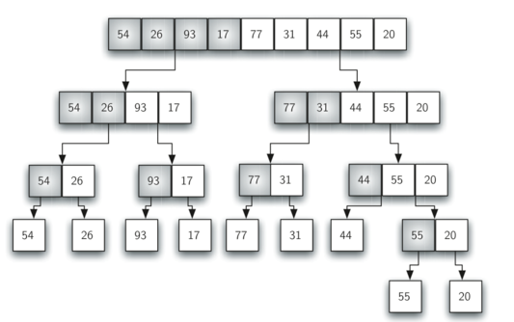
Merge Sort

Slide 35
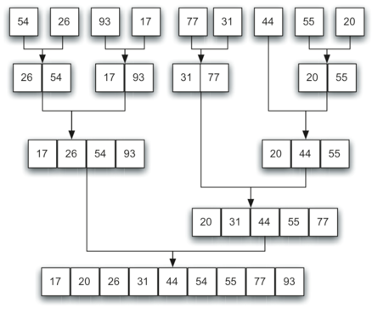
Merge Sort

Slide 36
Time Complexity of Merge Sort
Time Complexity:
Recurrence Relation for Merge sort:
T(n) = 1 if n=1
T(n) = 2 T(n/2) + O(n) if n>1
Solving this recurrence we get
T(n) = O(nlogn)
We can divide a list in half logn times where n is the length of the list. The second process is the merge. Each item in the list will eventually be processed and placed on the sorted list. So the merge operation which results in a list of size n requires n operations. The result of this analysis is that logn splits, each of which costs n for a total of nlogn operations. A merge sort is an O(nlogn) algorithm.

Slide 37
Shell sort
Shell sort is a highly efficient sorting algorithm and is based on insertion sort algorithm. This algorithm avoids large shifts as in case of insertion sort, if the smaller value is to the far right and has to be moved to the far left.

Slide 38
How Shell Sort Works?
For our example and ease of understanding, we take the interval of 4. Make a virtual sub-list of all values located at the interval of 4 positions. Here these values are {35, 14}, {33, 19}, {42, 27} and {10, 14}
We compare values in each sub-list and swap them (if necessary) in the original array. After this step, the new array should look like this −

Slide 39
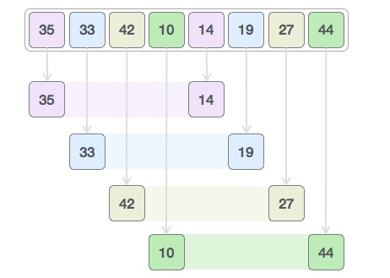

How Shell Sort Works?

Slide 40
Heap Sort
Heap sort is a comparison based sorting technique based on Binary Heap data structure. It is similar to selection sort where we first find the maximum element and place the maximum element at the end. We repeat the same process for remaining element.
A Binary Heap is a Complete Binary Tree where items are stored in a special order such that value in a parent node is greater(or smaller) than the values in its two children nodes.

Slide 41
Heap Sort
Heap sort algorithm is divided into two basic parts :
Creating a Heap of the unsorted list.
Then a sorted array is created by repeatedly removing the largest/smallest element from the heap, and inserting it into the array. The heap is reconstructed after each removal.

Slide 42
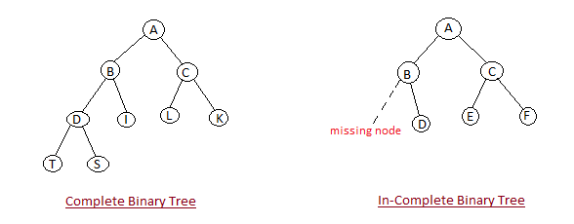
Heap property
Shape Property : Heap data structure is always a Complete Binary Tree, which means all levels of the tree are fully filled except possibly the lowest.

Slide 43
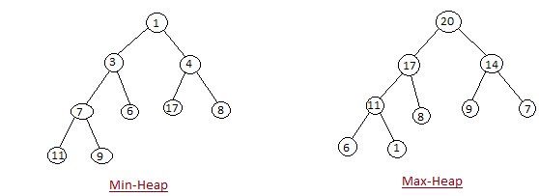
Heap property
Heap Property : All nodes are either [greater than or equal to] or [less than or equal to] each of its children. If the parent nodes are greater than their children, heap is called a Max-Heap, and if the parent nodes are smaller than their child nodes, heap is called Min-Heap.

Slide 44
Working of Heap Sort
Initially on receiving an unsorted list, the first step in heap sort is to create a Heap data structure(Max-Heap or Min-Heap). Once heap is built, the first element of the Heap is either largest or smallest(depending upon Max-Heap or Min-Heap), so we put the first element of the heap in our array. Then we again make heap using the remaining elements, to again pick the first element of the heap and put it into the array. We keep on doing the same repeatedly until we have the complete sorted list in our array.

Slide 45
Radix Sort
radix sort is a non-comparative integer sorting algorithm that sorts data with integer keys by grouping keys by the individual digits which share the same significant position and value
The idea of Radix Sort is to do digit by digit sort starting from least significant digit to most significant digit. Radix sort uses counting sort as a subroutine to sort.
Note: The order in which we divide and reassemble the list is extremely important, as this is one of the foundations of this algorithm.

Slide 46
Radix Sort
Idea to follow in radix sort:
Each key is first figuratively dropped into one level of buckets (sometimes called counting array) corresponding to the value of the rightmost digit. Each bucket preserves the original order of the keys as the keys are dropped into the bucket. There is a one-to-one correspondence between the buckets and the values that can be represented by the rightmost digit. Then, the process repeats with the next neighboring more significant digit until there are no more digits to process. In other words:
Take the least significant digit (or group of bits, both being examples of radices) of each key.
Group the keys based on that digit, but otherwise keep the original order of keys.
Repeat the grouping process with each more significant digit.

Slide 47
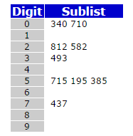
Radix Sort tracing
Consider the following list of unsorted list of numbers 493 812 715 710 195 437 582 340 385
We should start sorting by comparing and ordering the one's digits:
Now, we gather the sublists (in order from the 0 sublist to the 9 sublist) into the main list again:
340 710 812 582 493 715 195 385 437

Slide 48
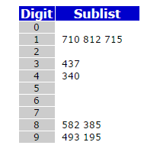
Radix Sort tracing
Original List: 493 812 715 710 195 437 582 340 385
Now, the sublists are created again, this time based on the ten's digit:
Now the sublists are gathered in order from 0 to 9:
710 812 715 437 340 582 385 493 195

Slide 49
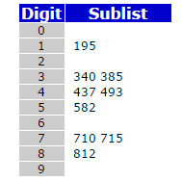
Radix Sort tracing
Original List: 493 812 715 710 195 437 582 340 385
Finally, the sublists are created according to the hundred's digit:
At last, the list is gathered up again:
195 340 385 437 493 582 710 715 812

Slide 50
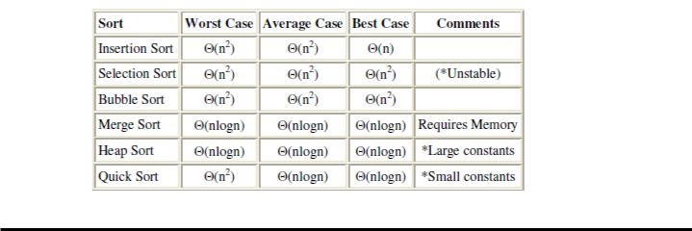
Sorting Camparision

